Slide 1

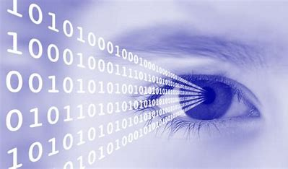
Image Processing Project
Fake Currency Identification
Submitted to :
Dr Susham Biswas
Associate Professor
Department Of Computer Science & Engineering
Submitted By
Utkarsh Shukla
B.Tech, 3rd Year
Petroleum Engineering

Slide 2
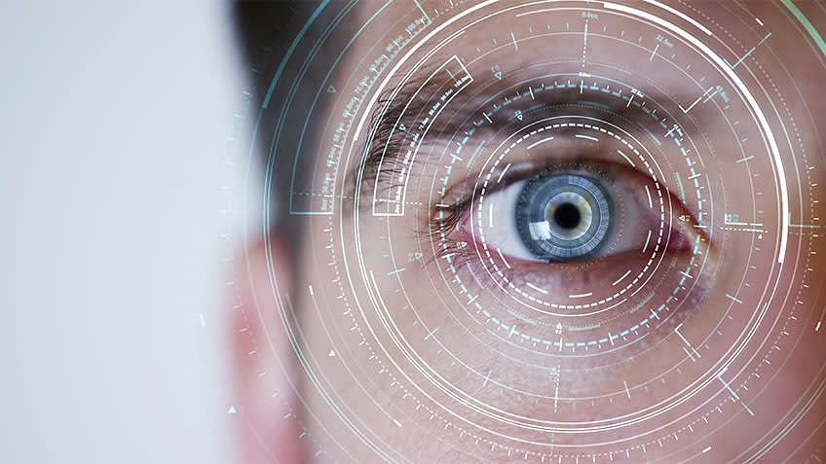
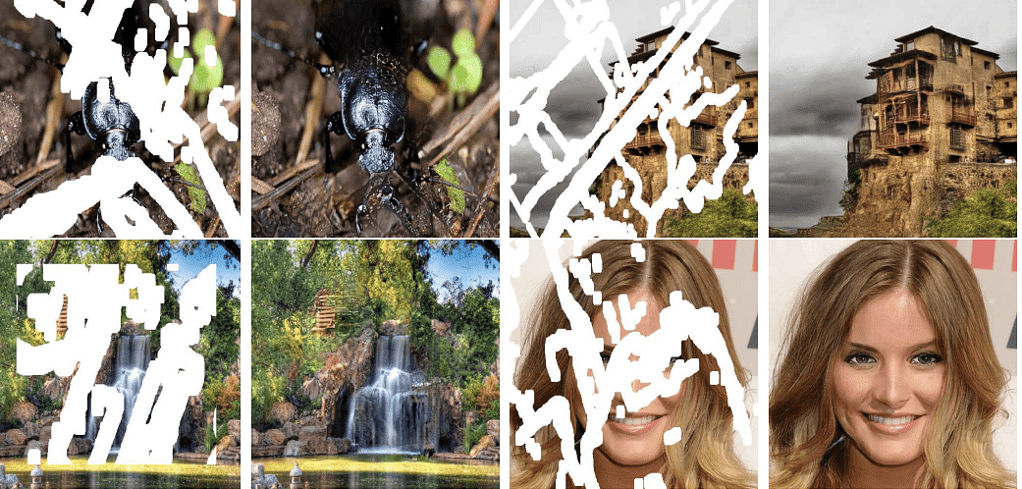
Image Processing
Image processing is the process of transforming an image into a digital form and performing certain operations to get some useful information from it.
Fundamental Step :
Image Acquisition
Image enhancement
Image Restoration
Colour Image Processing
Wavelets and Multiresolution Processing

Slide 3



Pixel
This pixel is a point on the image that takes on a specific shade, opacity or colour.
Grayscale - A pixel is an integer with a value between 0 to 255 (0 is completely black and 255 is completely white).
RGB - A pixel is made up of 3 integers between 0 to 255 (the integers represent the intensity of red, green, and blue).
RGBA - It is an extension of RGB with an added alpha field presenting the image’s opacity.

Slide 4
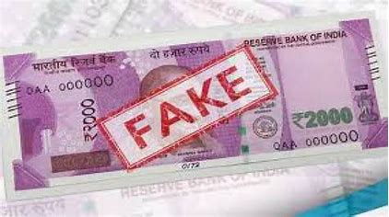
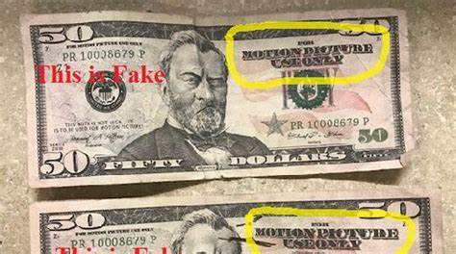
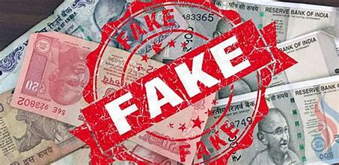


About The Project :
I have taken 2 images of currency notes in which one is a real note and another one is a fake note.
My aim is to detect fake currency with this project.
For my project, I used MATLAB as an IDE.

Slide 5
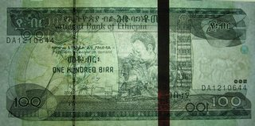
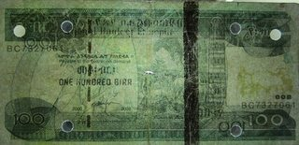
The Note I have Taken :
Real Image
Fake Image
http://i.stack.imgur.com/SqbnIm.jpg
http://i.stack.imgur.com/2U3DEm.jpg

Slide 6
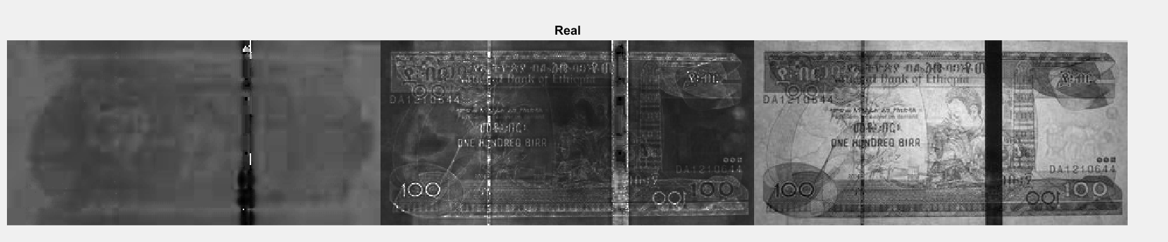
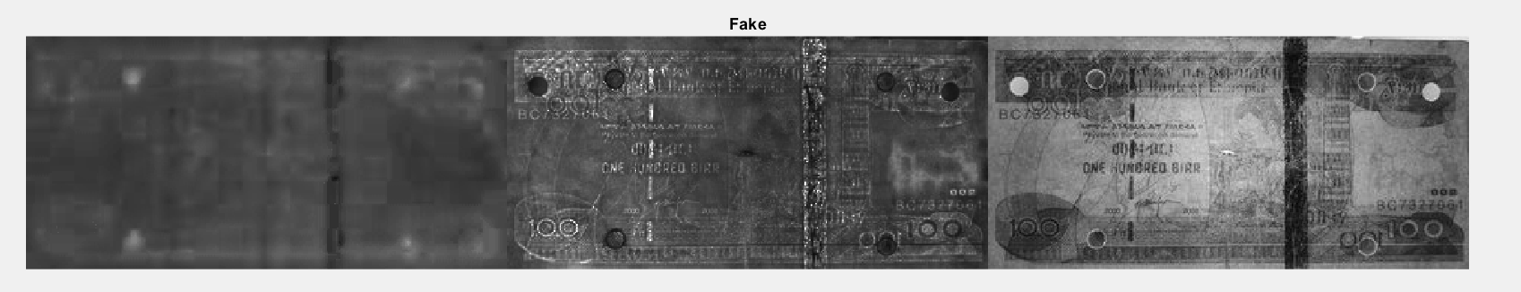
By Processing :
1. Decompose Image to HSV (Hue-Saturation Value

Slide 7
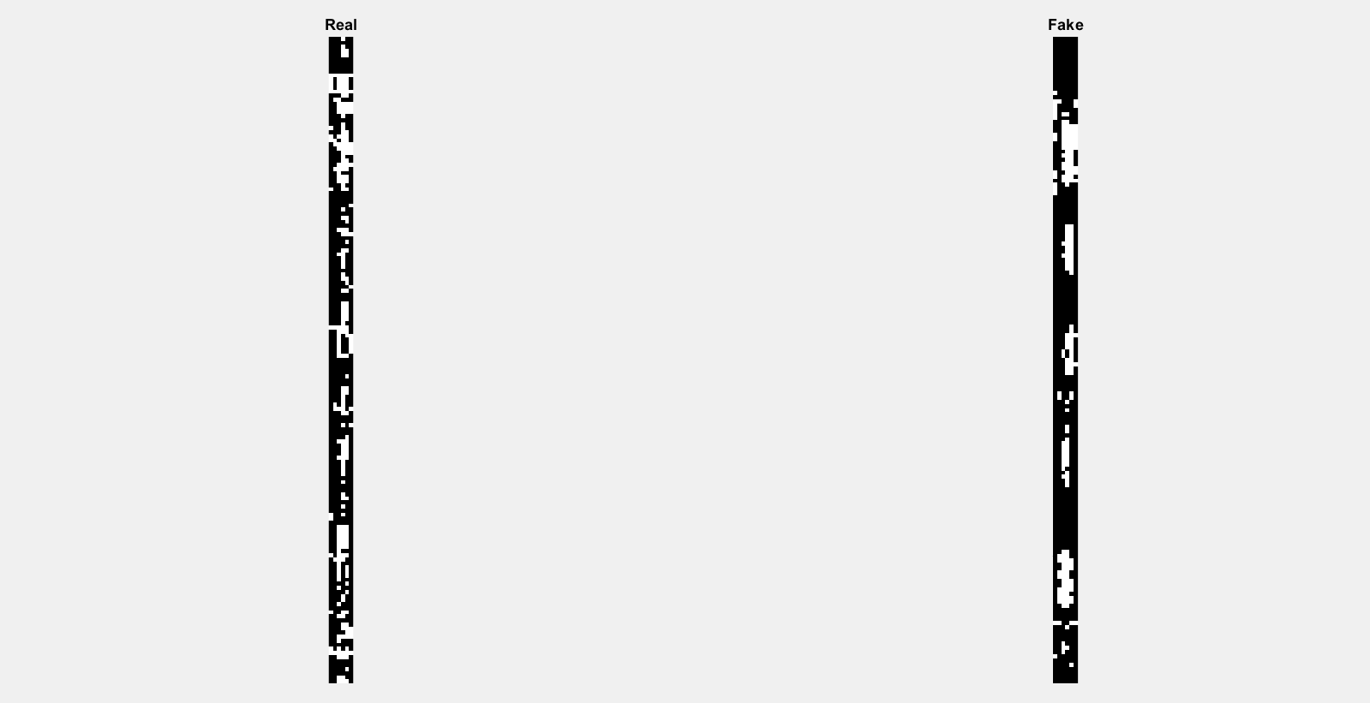
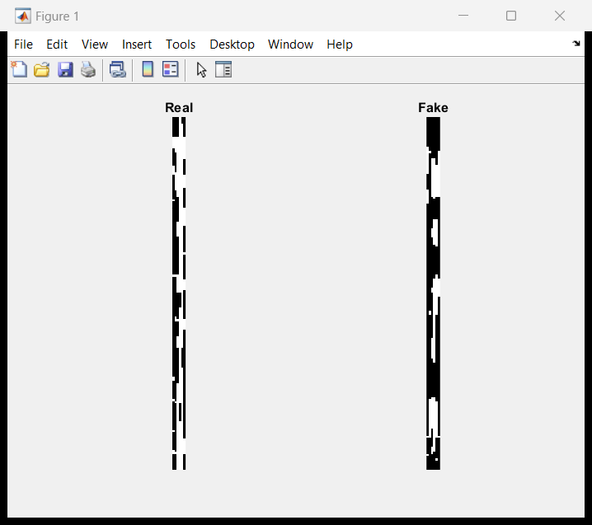
2. Threshold the saturation and value planes to create a binary image
I'm going to threshold the image looking at the saturation and value planes. Any points that have a combined saturation that is rather high and values that are rather low are candidates that are part of the black strip. I am going to crop out just the strips by themselves to make things easier
3. Do some minor closings

Slide 8
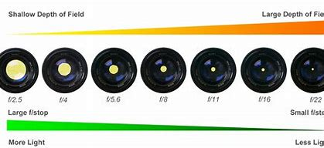
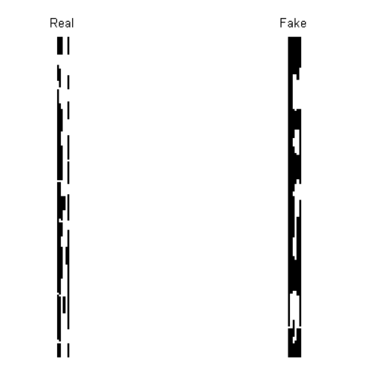
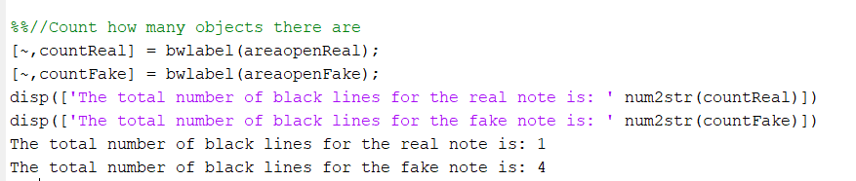
4. Final Clean Up
Now the function removes pixel areas in a black-and-white image that have less than a certain area. I'm going to choose 15 to get rid of the pixels along the edges that don't belong to the strip.
Output :

Slide 9

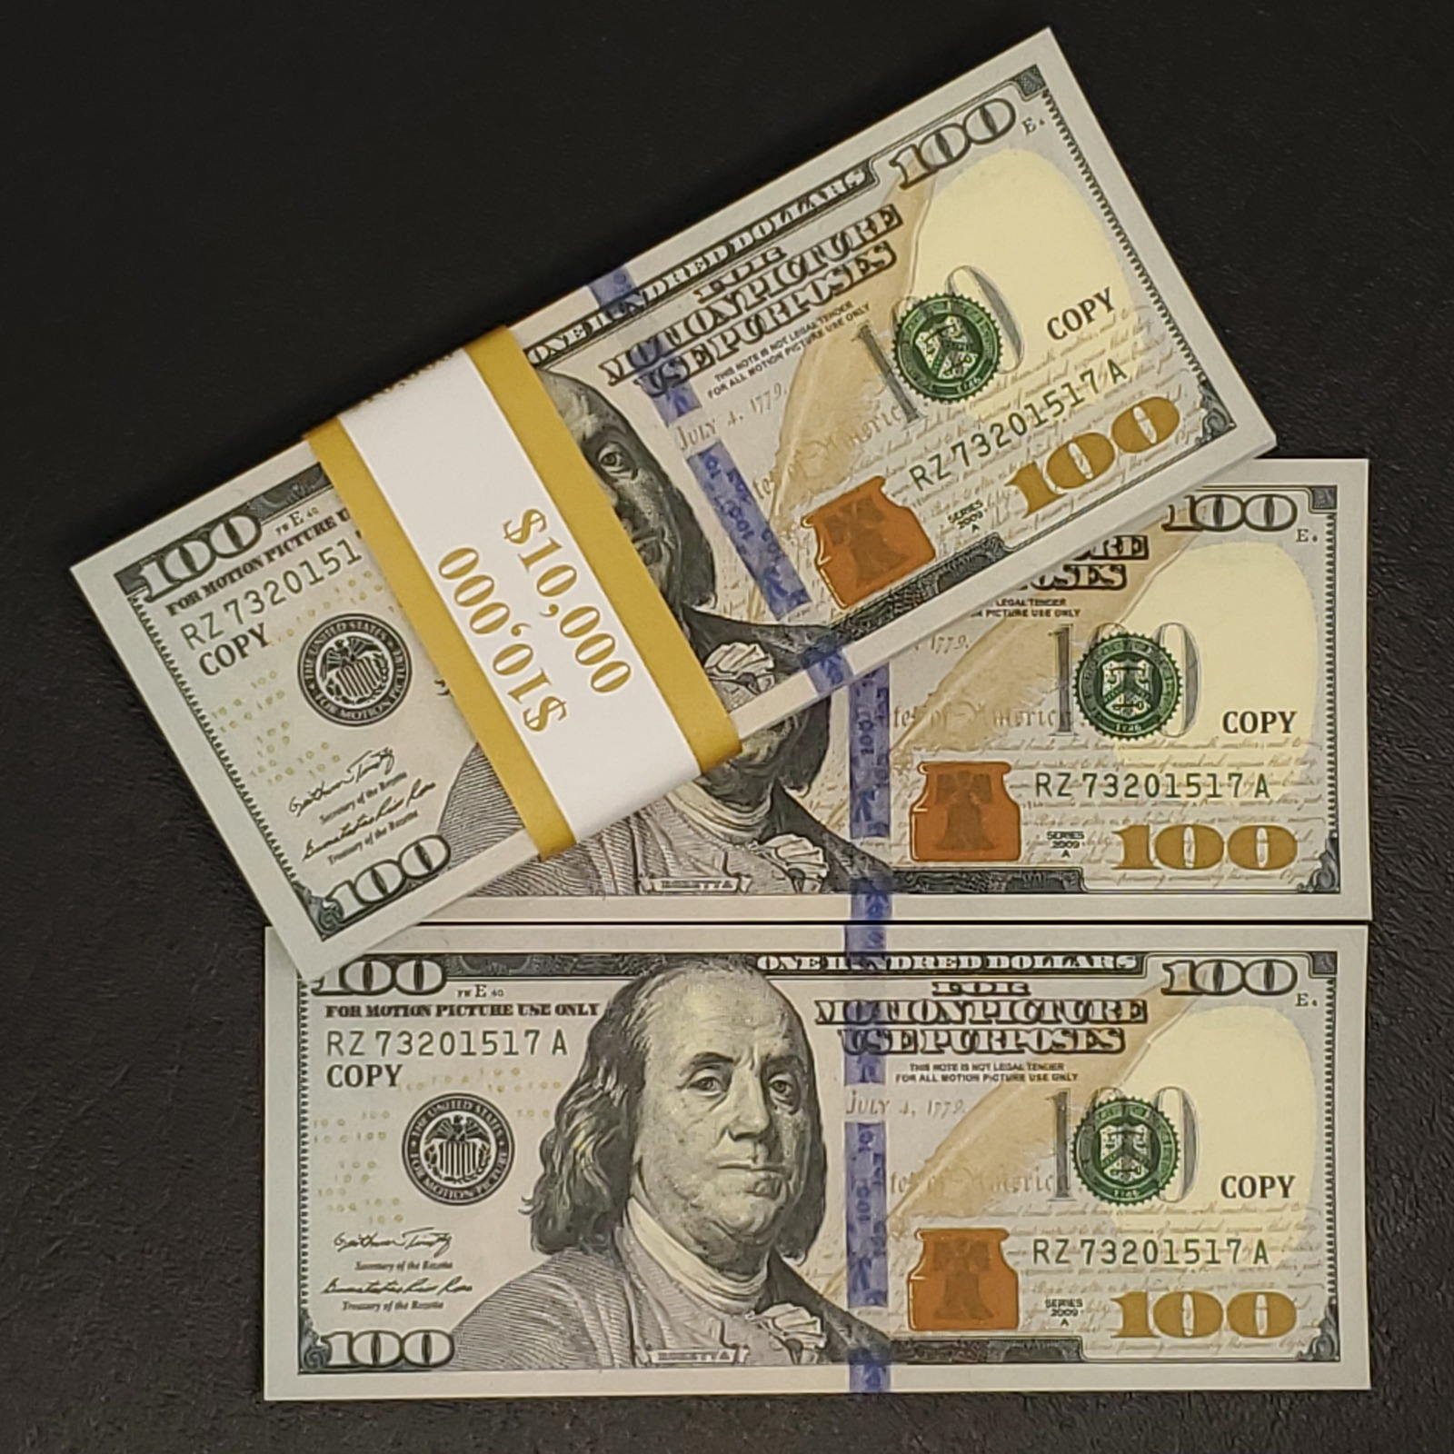
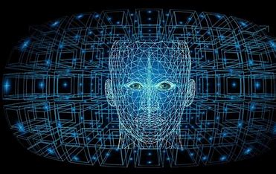
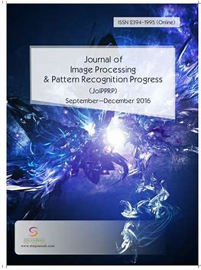
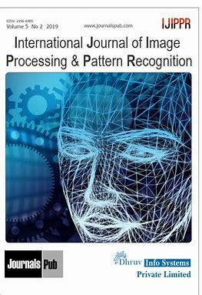
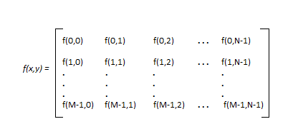
References :
matlab - Bing images
fake currency ideas - Bing images
What is Image Processing? Meaning, Techniques, Segmentation & Important Facts to Know (simplilearn.com)
Digital Image Processing Basics - GeeksforGeeks

Slide 10

Thank You
Hope You Liked It

